Slide 1
Multidimensional Scaling:
Dimension Reduction Technique

Slide 2
Multidimensional Scaling (MDS) is a dimension reduction technique used to visualize the level of similarity or dissimilarity of data in a lower-dimensional space.
It is primarily used in exploratory data analysis and
Visualization of high-dimensional data.
Similarity measures are used to determine how similar two datasets or data points are, while dissimilarity measures are used to determine how different they are

Slide 3
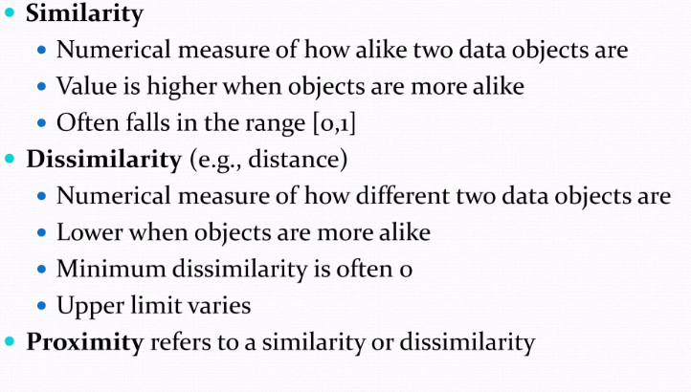
Similarity or Dissimilarity

Slide 4
Types of MDS
Two main types of MDS:
Metric MDS: Uses a given distance matrix and tries to preserve those distances in the lower-dimensional representation.
Non-Metric MDS: Uses only the rank order of distances rather than exact values.
Non-Metric MDS only focuses on maintaining the relative order of distances (which pair is closer or farther apart) without being concerned with the exact distance values themselves

Slide 5
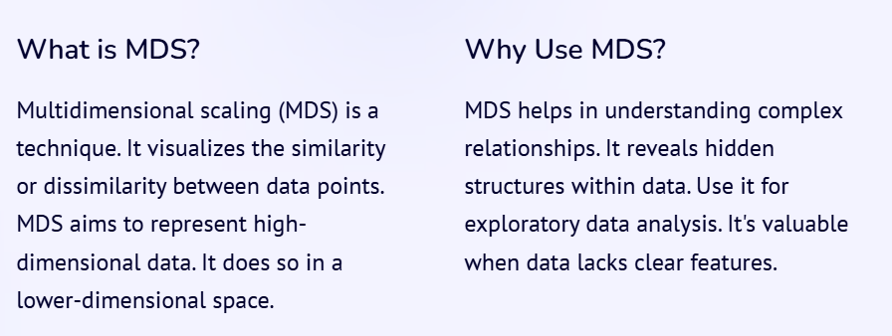

Slide 6
Steps in MDS
Compute the dissimilarity matrix (e.g., using Euclidean distance).
Assign initial coordinates in a lower-dimensional space.
Minimize a stress function to adjust the positions of points to best preserve distances.
The stress function is a measure of the deviation of the distances in the lower-dimensional space from the distances in the original space and is used to evaluate the quality of the projection.
Metric MDS minimizes the cost function called “stress” which is a residual sum of squares: for distance.
It consists of the square root of the normalized squared discrepancies between interpoint distances in the
MDS plot and the smoothed distances predicted from the dissimilarities.
Stress varies between 0 and 1, with values near 0 indicating better fit.
Visualize the output in 2D or 3D space.

Slide 7
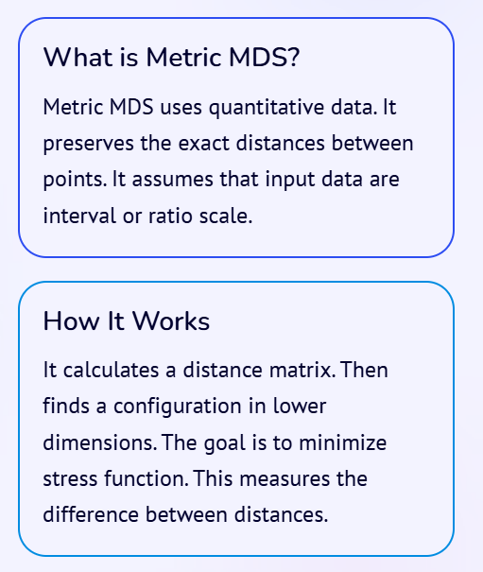
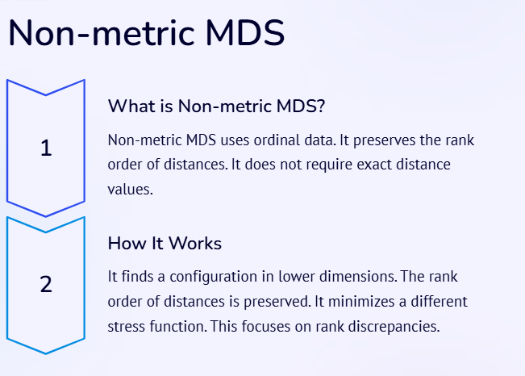

Slide 8
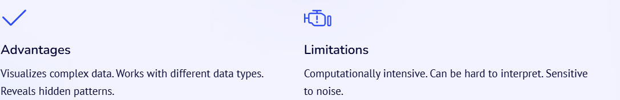

Slide 9
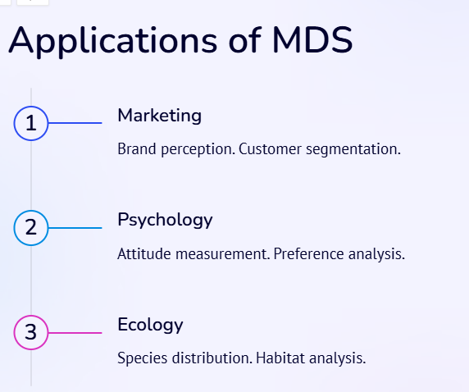
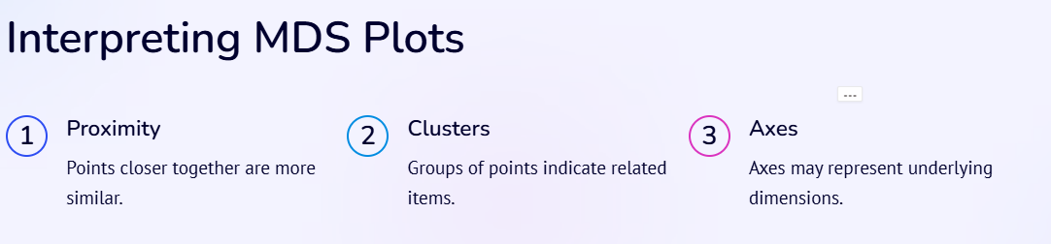
Applications of MDS
Marketing research (customer preference analysis)
Psychology (perceptual mapping)
Bioinformatics (genetic distance analysis)
Social sciences (opinion surveys)

Slide 10
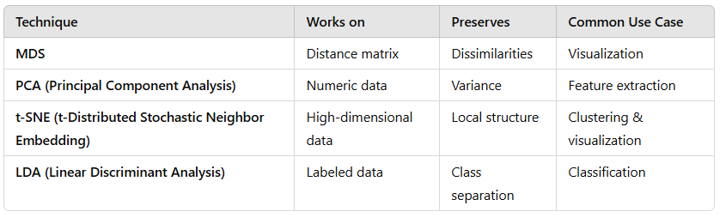
MDS vs. Other Dimension Reduction Techniques

Slide 11
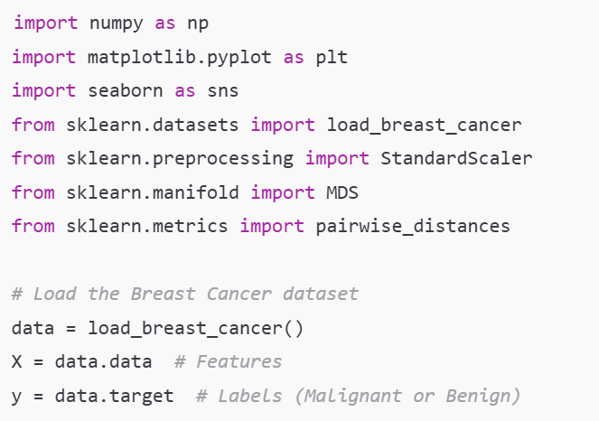

Slide 12
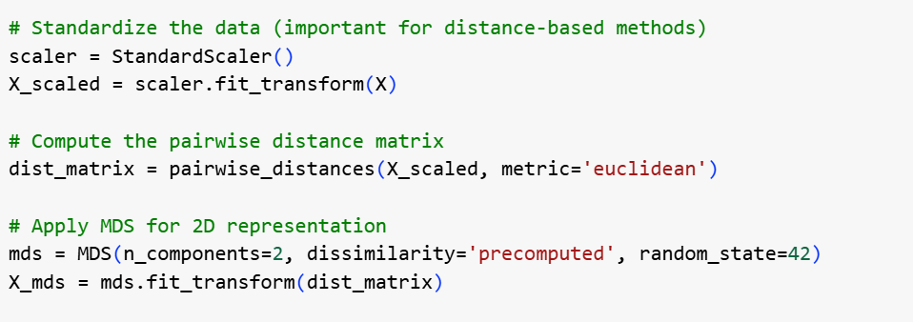

Slide 13
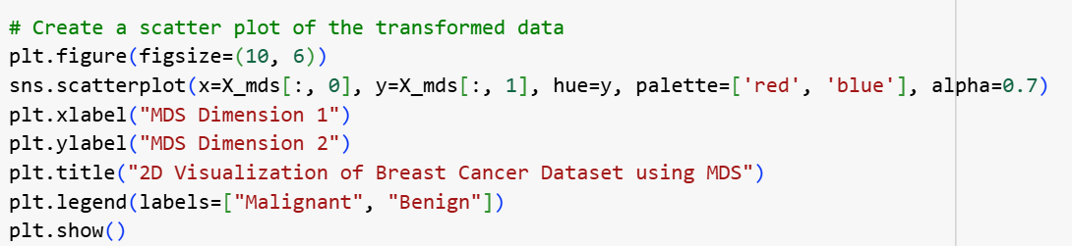
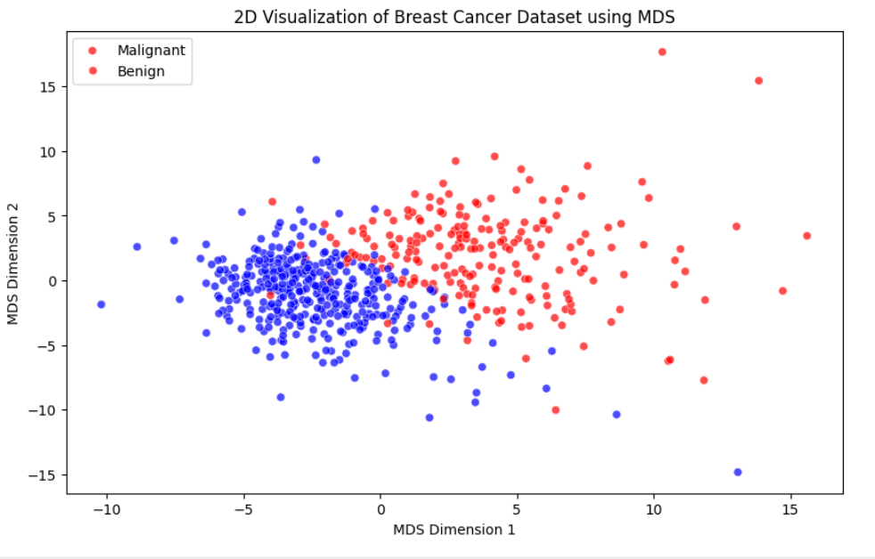

Slide 14
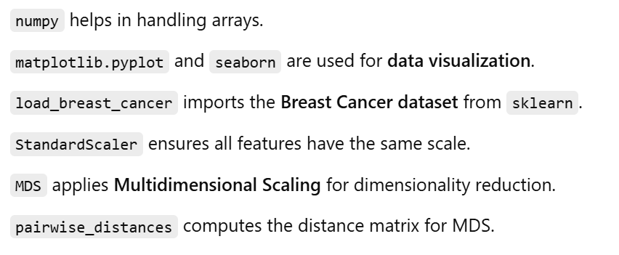
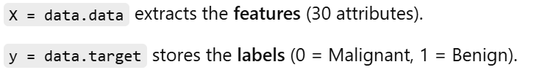
dataset Link: https://archive.ics.uci.edu/dataset/17/breast+cancer+wisconsin+diagnostic

Slide 15
